Slide 2
developing and testing MapReduce jobs with MRUnit,
developing and testing MapReduce jobs running in local mode

Slide 3
Developing and testing MapReduce jobs with MRUnit
Map Phase

Slide 4
Developing and testing MapReduce jobs with MRUnit
Reduce Phase

Slide 5
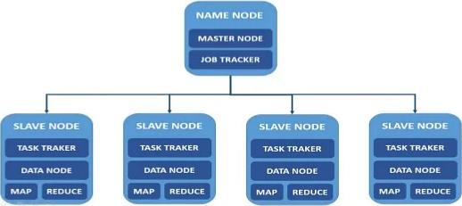
Developing and testing MapReduce jobs with MRUnit
Complexities arise due to the distributed nature of Hadoop

Slide 6
Developing and testing MapReduce jobs with MRUnit
Prior to the release of MRUnit by Cloudera, even the simplest tests running in local mode would have to read from the disk and take several seconds each to set up and run.

Slide 7
Developing and testing MapReduce jobs with MRUnit
MRUnit removes as much of the Hadoop framework.
The focus is narrowed to the map and reduce code.
Developing and testing MapReduce code can be done entirely in the IDE.

Slide 8
Developing and testing MapReduce jobs with MRUnit
How MRUnit uses the IdentityMapper provided by the MapReduce framework in the lib folder.
It takes a key-value pair as input.

Slide 9
Developing and testing MapReduce jobs with MRUnit
The Identity Mapper takes a key-value pair as input and emits the same key-value pair, unchanged.

Slide 10
Developing and testing MapReduce jobs with MRUnit
Step1: Download the latest version of MRUnit from http://mrunit.apache.org/ general/downloads.html
Step2: Create a new Java project
Step3: Add the mrunit-X.Y.Z-incubating-hadoop1.jar file and other Hadoop JAR files to the build path of the Java project
Step4: Create a new class named IdentityMapperTest
Step5: For the full source, review the IdentityMapperTest.java file in the source code.

Slide 11
Developing and testing MapReduce jobs with MRUnit
Step1: Download the latest version of MRUnit from http://mrunit.apache.org/ general/downloads.html
Step2: Create a new Java project
Step3: Add the mrunit-X.Y.Z-incubating-hadoop1.jar file and other Hadoop JAR files to the build path of the Java project
Step4: Create a new class named IdentityMapperTest
Step5: For the full source, review the IdentityMapperTest.java file in the source code.

Slide 12
Developing and testing MapReduce jobs with MRUnit
Step1: Download the latest version of MRUnit from http://mrunit.apache.org/ general/downloads.html
Step2: Create a new Java project
Step3: Add the mrunit-X.Y.Z-incubating-hadoop1.jar file and other Hadoop JAR files to the build path of the Java project
Step4: Create a new class named IdentityMapperTest
Step5: For the full source, review the IdentityMapperTest.java file in the source code.

Slide 13
Developing and testing MapReduce jobs with MRUnit
Step1: Download the latest version of MRUnit from http://mrunit.apache.org/ general/downloads.html
Step2: Create a new Java project
Step3: Add the mrunit-X.Y.Z-incubating-hadoop1.jar file and other Hadoop JAR files to the build path of the Java project
Step4: Create a new class named IdentityMapperTest
Step5: For the full source, review the IdentityMapperTest.java file in the source code.

Slide 14
Developing and testing MapReduce jobs with MRUnit
Step1: Download the latest version of MRUnit from http://mrunit.apache.org/ general/downloads.html
Step2: Create a new Java project
Step3: Add the mrunit-X.Y.Z-incubating-hadoop1.jar file and other Hadoop JAR files to the build path of the Java project
Step4: Create a new class named IdentityMapperTest
Step5: For the full source, review the IdentityMapperTest.java file in the source code.

Slide 15
Developing and testing MapReduce jobs with MRUnit
Follow these steps to test a mapper with MRUnit
public class IdentityMapperTest extends TestCase
private Mapper identityMapper;
private MapDriver mapDriver;
@Before
public void setup() { identityMapper = new IdentityMapper(); mapDriver = new MapDriver(identityMapper); }

Slide 16
Developing and testing MapReduce jobs with MRUnit
Follow these steps to test a mapper with MRUnit
public class IdentityMapperTest extends TestCase
private Mapper identityMapper;
private MapDriver mapDriver;
@Before
public void setup() { identityMapper = new IdentityMapper(); mapDriver = new MapDriver(identityMapper); }

Slide 17
Developing and testing MapReduce jobs with MRUnit
Follow these steps to test a mapper with MRUnit
public class IdentityMapperTest extends TestCase
private Mapper identityMapper;
private MapDriver mapDriver;
@Before
public void setup() { identityMapper = new IdentityMapper(); mapDriver = new MapDriver(identityMapper); }

Slide 18
Developing and testing MapReduce jobs with MRUnit
Follow these steps to test a mapper with MRUnit
4. @Test
public void testIdentityMapper1() {
mapDriver.withInput(new Text("key"), new Text("value")) mapDriver.withOutput(new Text("key"), new Text("value"))
.runTest();
}

Slide 19
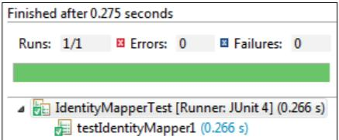
Developing and testing MapReduce jobs with MRUnit
Follow these steps to test a mapper with MRUnit
5. Run the application

Slide 20
Developing and testing MapReduce jobs with MRUnit
6. @Test
public void testIdentityMapper2() {
mapDriver.withInput(new Text("key"), new Text("value"))
mapDriver.withOutput(new Text("key2"), new Text("value2"))
mapDriver.runTest();
}

Slide 21
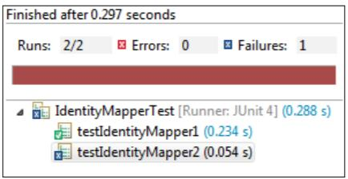
Developing and testing MapReduce jobs with MRUnit
7. Run the application again

Slide 22
Developing and testing MapReduce jobs running in local mode

Slide 23
Developing and testing MapReduce jobs running in local mode
Getting ready
Download the weblog_entries_bad_records.txt dataset from the Packt website, http://www.packtpub.com/support.

Slide 24
Developing and testing MapReduce jobs running in local mode
Getting ready
Download the weblog_entries_bad_records.txt dataset from the Packt website, http://www.packtpub.com/support.
CounterExample.java class

Slide 25
Developing and testing MapReduce jobs running in local mode
Getting ready
Download the weblog_entries_bad_records.txt dataset from the Packt website, http://www.packtpub.com/support.
CounterExample.java class
Using Counters in a MapReduce job to track bad records recipe.

Slide 26
Developing and testing MapReduce jobs running in local mode
How to do it...
Step1: Open the $HADOOP_HOME/conf/mapred-site.xml file in a text editor.
Step2:
<property>
<name>mapred.job.tracker</name>
<value>local</value>
</property>

Slide 27
Developing and testing MapReduce jobs running in local mode
How to do it...
core-site.xml file
3. Set the fs.default.name property value to file:///:
<property>
<name>fs.default.name</name>
<value>file:///</value>
</property>

Slide 28
Developing and testing MapReduce jobs running in local mode
How to do it...
4. hadoop-env.sh file and add the following line:
export HADOOP_OPTS="-agentlib:jdwp=transport=dt_socket,server=y, suspend=y,address=7272"

Slide 29
Developing and testing MapReduce jobs running in local mode
How to do it...
5. $HADOOP_HOME/bin/hadoop jar ./CountersExample.jar com.packt. hadoop.solutions.CounterExample /local/path/to/weblog_entries_bad_ records.txt /local/path/to/weblog_entries_clean.txt
You'll get the following output:
Listening for transport dt_socket at address: 7272

Slide 30
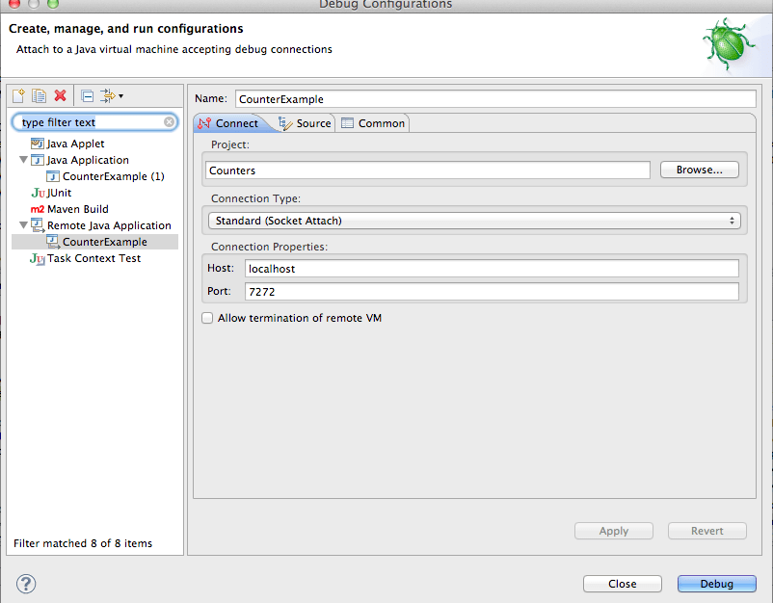
Developing and testing MapReduce jobs running in local mode
6.

Slide 31
Developing and testing MapReduce jobs running in local mode
7. Create a new breakpoint and debug.

